Slide 1
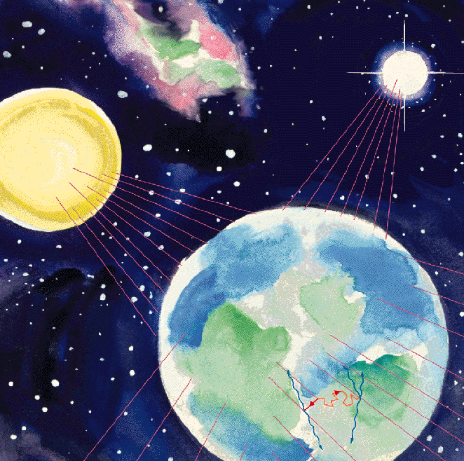


元素合成
Nucleosynthesis and Neutrinos
と
ニュトリノ
A.B. Balantekin

Slide 2
How Stars Shine?
Hans Bethe

Slide 3
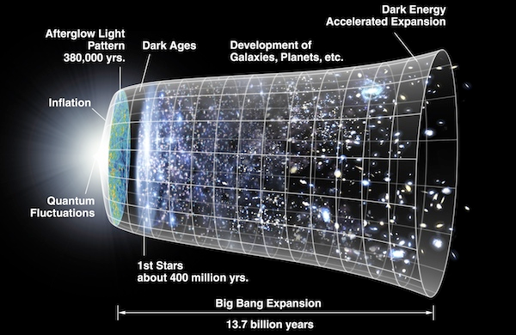
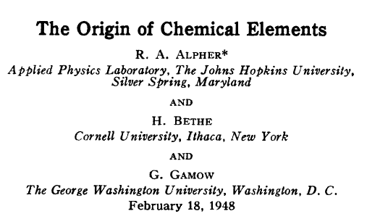
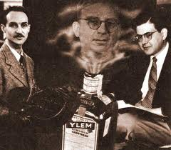

Slide 4
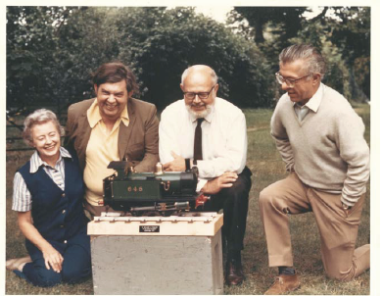
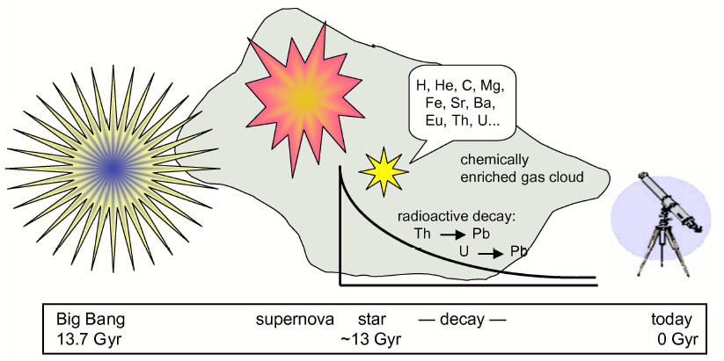
Nucleosynthesis takes place in
The Early Universe
Stellar Evolution
Core-Collapse Supernovae
……
Adopted from Frebel

Slide 5
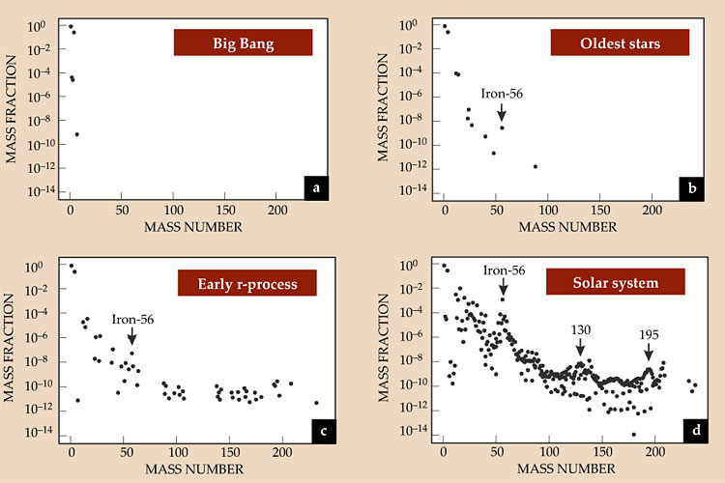
From H. Schatz

Slide 6
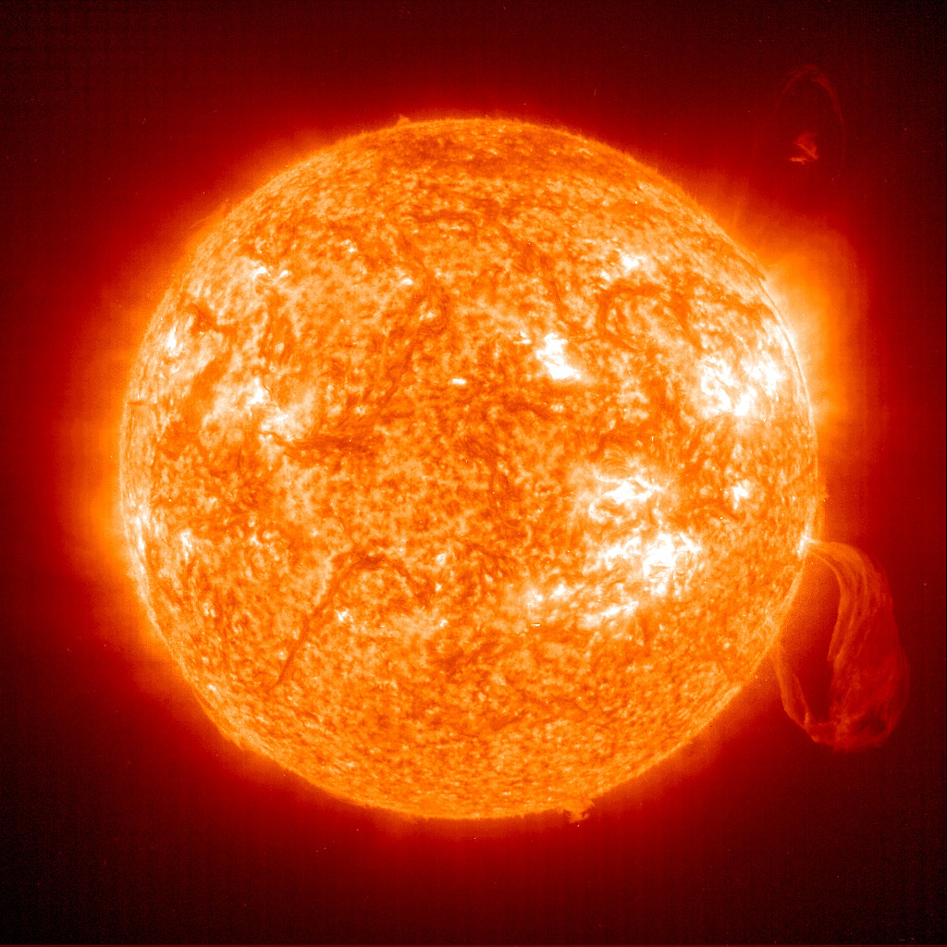
The Sun

Slide 7
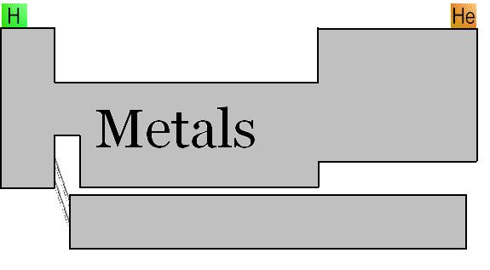
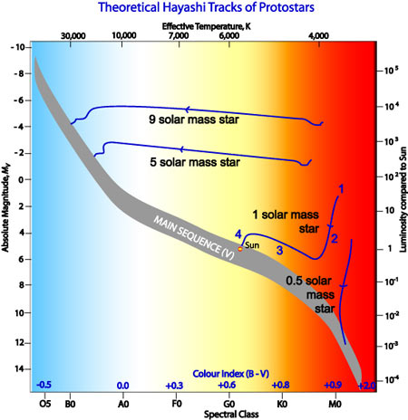
X
Y
SSM assumption: The proto-Sun follows the convective Hayashi track ➔ zero-age Sun is homogeneous, i.e Z_{initial} = Z_{surface_today}
Z
Initial parameters: Y_{initial}, Z_{initial}, solar mixing length
X+Y+Z=1
Evolve forward to today to reproduce present R, L, and Y_{surface}
Z_{surface_today} is deduced from photospheric absorption lines, which were recently evaluated using 3D methods. Z_{surface_today} obtained using improved methods does not match Z_{initial} of the SSM!

Slide 8
This fixes some old puzzles
But creates new ones!
new
old
Sun is no longer an “odd” star enriched in heavy elements!
There is mismatch between the surface and the interior of the Sun!
Old ⁸B neutrino flux = 4x10⁶ cm⁻²s⁻¹
New ⁸B neutrino flux = 5.31x10⁶ cm⁻²s⁻¹

Slide 9
CNO Neutrinos are still not measured!
New Solar abundances:
Asplund et al. (AGSS09), (Z/X)=0.0178
Grevesse and Sauvel (GS98), (Z/X)=0.0229
Drastically different!
Open problem in solar physics!
New Evaluation of the nuclear reaction rates: Adelberger et al. (2011)
New solar model calculations:Serenelli

Slide 10
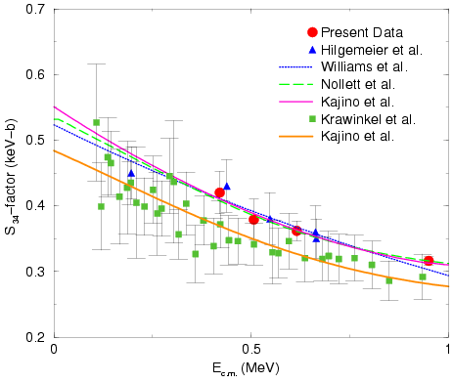
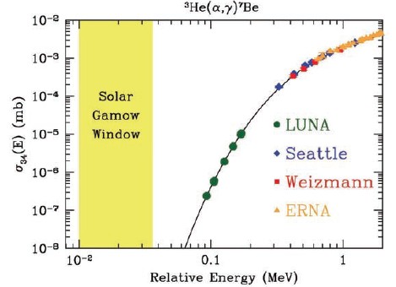
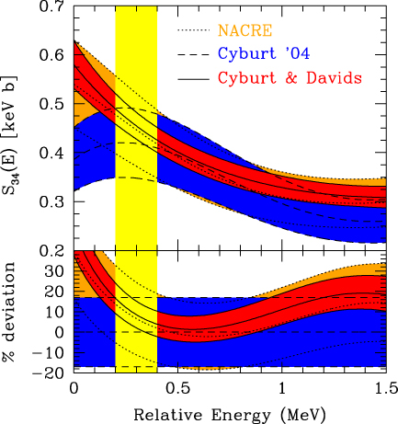
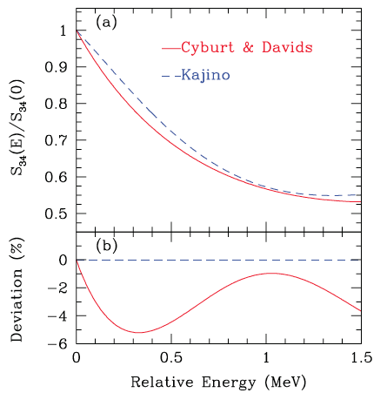
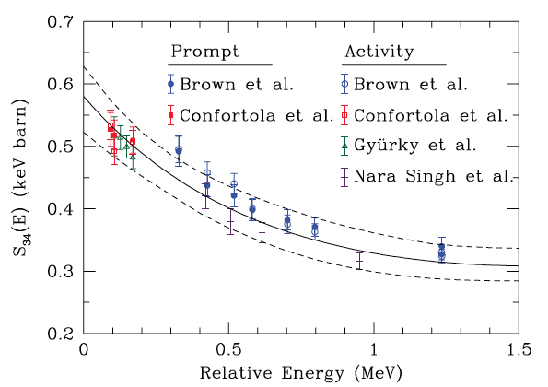
³He(α,γ)⁷Be
The main uncertainty for the Sun and Big-Bang nucleosynthesis

Slide 11
SSM Error Budget
Source | Percentage Error
Diffusion coefficient of SSM | 2.7%
Nuclear rates [mainly ⁷Be(p,γ)⁸B and ¹⁴N(p,γ)¹⁵O] | 9.9%
Neutrinos and weak interaction (mainly θ₁₂) | 3.2%
Other SSM input parameters | 0.6%
¹⁴N(p,γ)¹⁵O

Slide 12
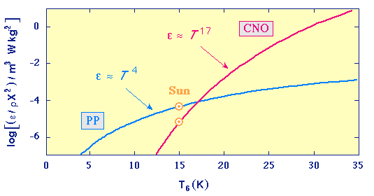
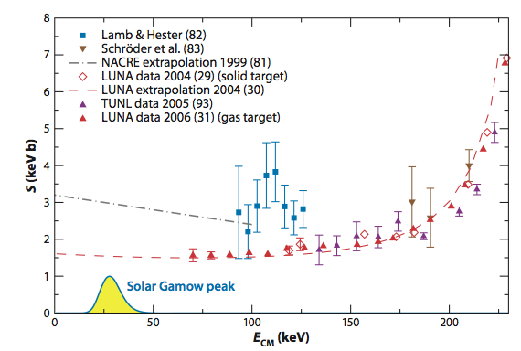
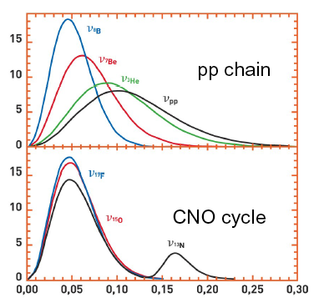
¹⁴N(p,γ)¹⁵O
The determining reaction for the CNO burning

Slide 13
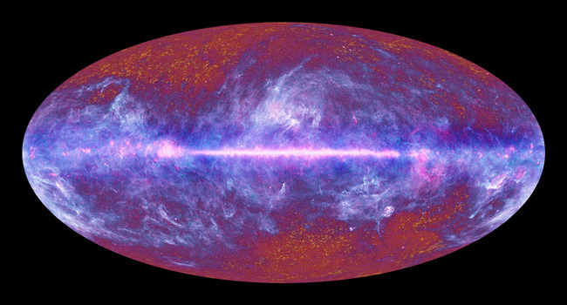
The Early Universe

Slide 14
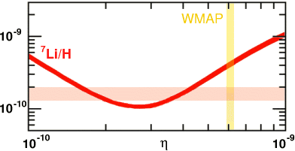
BBN Prediction
Observed value
⁷Li produced in the Big-Bang Nucleosynthesis dominates the observed ⁷Li abundance.
In 1982 Spite and Spite observed that low-metallicity halo stars exhibit a plateau of ⁷Li abundance indicating its primordial origin.
But WMAP observations imply 2~3 times more ⁷Li than that is observed in halo stars!

Slide 15
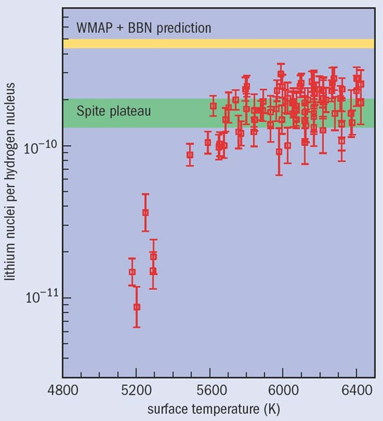
⁷Li needed to be consistent with the microwave photon observations
⁷Li observed in old halo stars
⁷Li is made in the Early Universe. But still much work needs to be done!

Slide 16
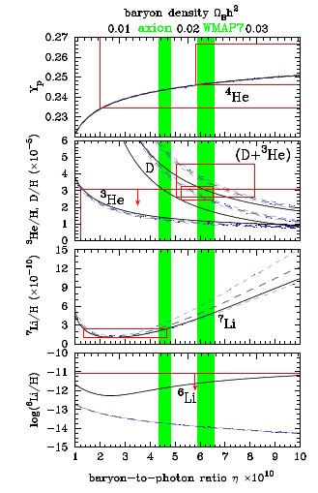
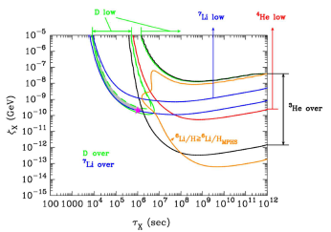
One possibility: Axion BEC causes photons to lose energy: Erken, et al., PRL 108, 061304 (2012).
But this creates a problem with the deuterium abundance.
Solution: Introduce particles that decay into non-thermal photons. Kusakabe, Balantekin, Kajino and Pehlivan, arXiv:1202.5603 [astro-ph.CO].

Slide 17
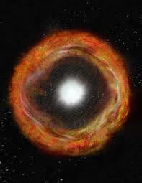
The core-collapse supernovae

Slide 18
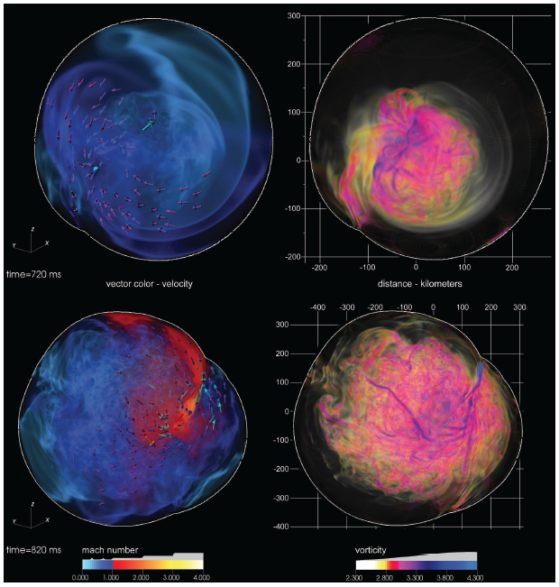
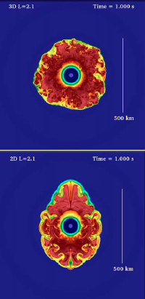
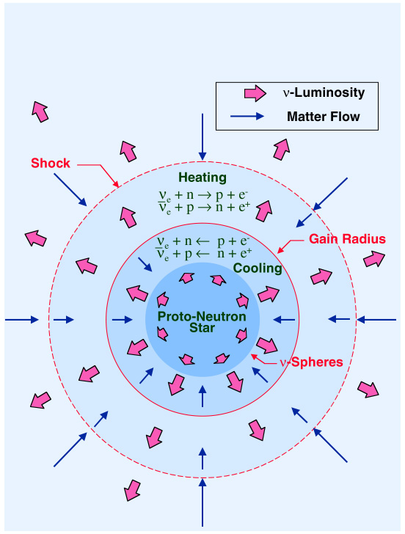
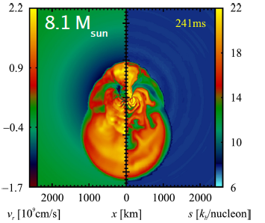
ORNL/UT
Development of 2D and 3D models for core-collapse supernovae: Complex interplay between turbulence, neutrino physics and thermonuclear reactions.
3D
2D
Princeton
Munich

Slide 19
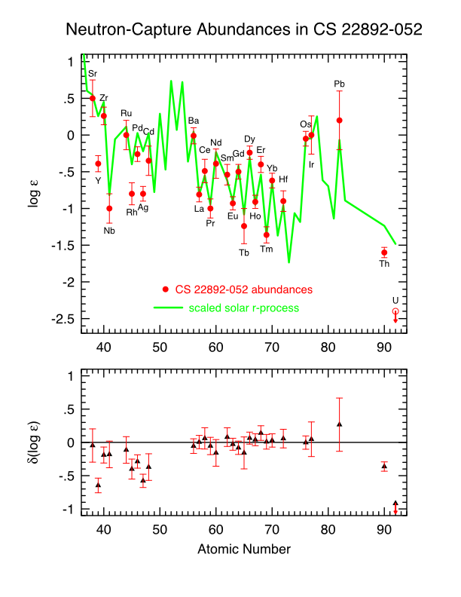
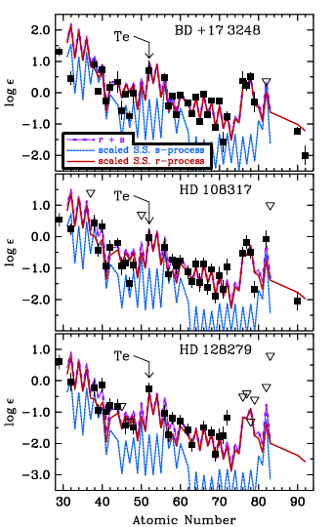
r-process nucleosynthesis
[Fe/H] ≈ -3.1
A > 100 abundance pattern fits the solar abundances well.
Roederer et al., Ap. J. Lett. 747, L8 (2012)

Slide 20
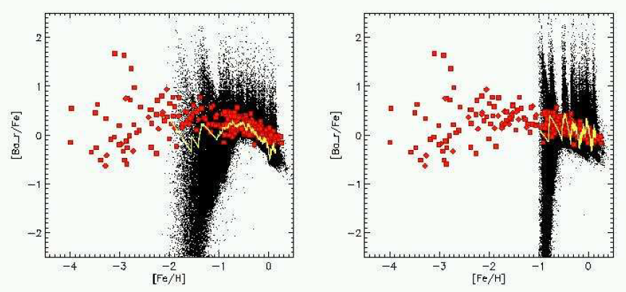
observations
Model calculations for neutron-star mergers
Coalescence timescale = 1 Myr
Average merger rate = 20/Myr
Average merger rate = 2/Myr
Star formation rate?
Argast et al., A&A, 416, 997 (2003)

Slide 21
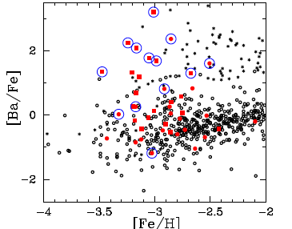
Yield of neutron star mergers
SDSS Data from Aoki et al., arXiv: 1210.1946 [astro-ph.SR]

Slide 22
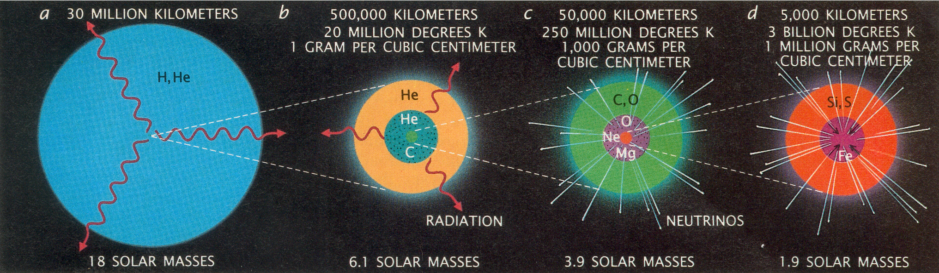
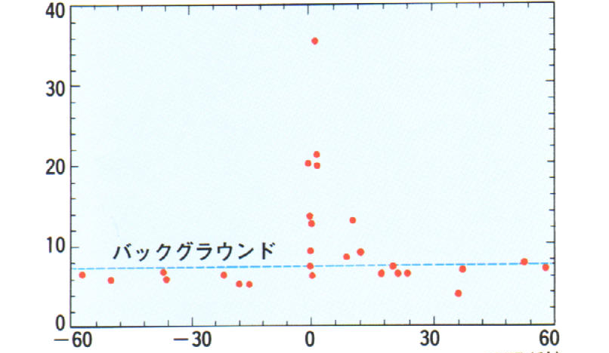
Neutrinos from core-collapse supernovae
M_{prog} ≥ 8 M_{sun} ⇒ ΔE ≈ 10⁵³ ergs ≈ 10⁵⁹ MeV
99% of the energy is carried away by neutrinos and antineutrinos with 10 ≤ E_{ν} ≤ 30 MeV ⇒ 10⁵⁸ neutrinos

Slide 23
Neutrinos dominate the energetics of core-collapse SN
Explosion only 1% of total energy
Total optical and kinetic energy = 10⁵¹ ergs
Total energy carried by neutrinos = 10⁵³ ergs
10% of star’s rest mass
Neutrino diffusion time, τ_{ν} ~ 2-10 s

Slide 24
Core-collapse supernovae are very sensitive to ν physics
Gravitational collapse yields very large values of the Fermi energy for electrons and ν_{e}’s (~10⁵⁷ units of electron lepton number). ν_{μ}’s and ν_{τ}’s are pair-produced, so they carry no μ or τ lepton number. Any process that changes neutrino flavor could increase electron capture and reduce electron lepton number.
Almost the entire gravitational binding energy of the progenitor star is emitted in neutrinos. Neutrinos transport entropy and the lepton number.
Electron fraction, or equivalently neutron-to-proton ratio (the controlling parameter for nucleosynthesis) is determined by the neutrino capture rates:

Slide 25


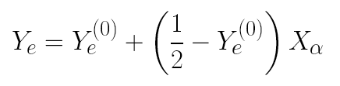
Neutrino spallation on alphas produce too many seed nuclei and too few free neutrons (wrecks the r-process at especially high entropy)
ν_{e} + n → p + e⁻
+ n → d + γ
(pushes Y_{e} toward 0.5)
If alpha particles are present
If alpha particles are absent
If Y_{e}⁽⁰⁾ < 1/2, non-zero X_{α} increases Y_{e}. If Y_{e}⁽⁰⁾ > 1/2, non-zero X_{α} decreases Y_{e.}
Non-zero X_{α} pushes Y_{e} to 1/2
Alpha effect

Slide 26
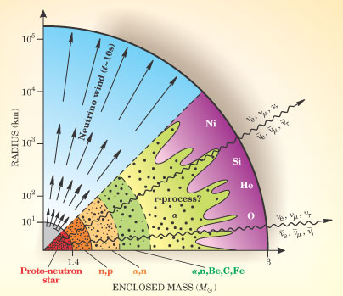
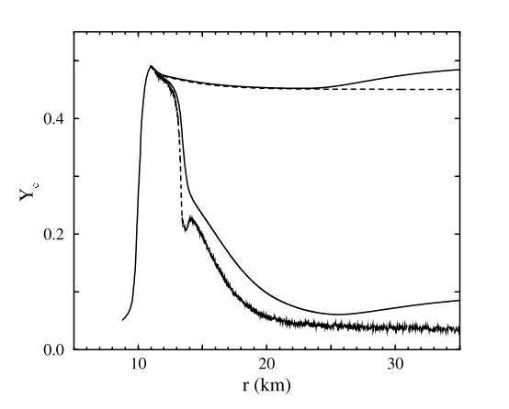
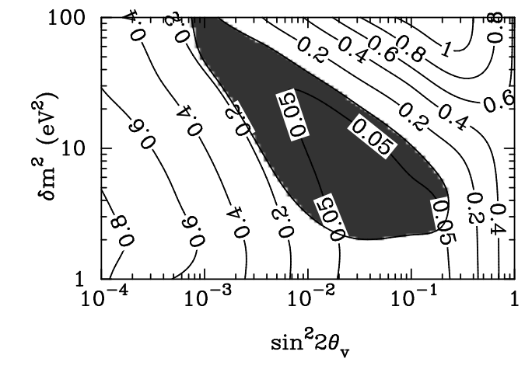
Alpha effect
Active-sterile mixing
McLaughlin, Fetter, Balantekin, Fuller, Astropart. Phys., 18, 433 (2003)

Slide 27
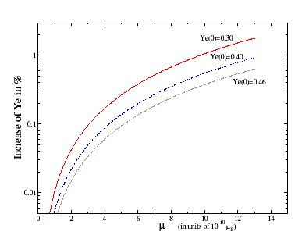
Can neutrino magnetic moment help with the alpha problem?
No!
For Dirac neutrinos
ν_{eL}→ sterile states
Both neutrinos and antineutrinos are reduced and the electron fraction increases!
Balantekin, Volpe, Welzel, JCAP 09 (2007).
4 km away from the neutron star surface

Slide 28
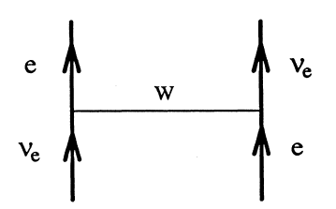
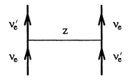
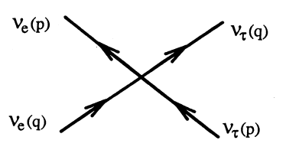
Extending the MSW effect
In vacuum: E² = p² + m²
In matter: (E-Φ)² = p² + m² ⇒ E² = p² + m_{eff}², m_{eff}² ≈ m² + 2EΦ
The potential is provided by the coherent forward scattering of ν_{e}’s off the electrons in dense matter.
There is a similar term with Z-exchange. But since it is the same for all neutrino flavors, it does not contribute at tree level to phase differences unless we invoke a sterile neutrino.
If the neutrino density itself is also very high then one has to consider the effects of neutrinos scattering off other neutrinos. This is the case for a core-collapse supernova.
Fuller, Qian, Raffelt, Smirnov, Duan, Balantekin, Pehlivan, Friedland, …

Slide 29
O-Ne-Mg core-collapse, 8 to 12 M
Fe core-collapse, more than 12 M
Both scenarios should be effected by neutrino-neutrino interactions

Slide 30
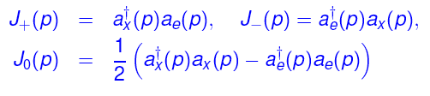
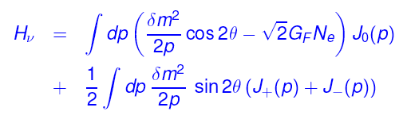

Algebraic description of the MSW effect
Neutrino flavor isospin algebra
Smirnov, Fuller and Qian, Pantaleone, McKellar, Friedland, Lunardini, Raffelt, Balantekin, Kajino, Pehlivan …
Neutrino-Neutrino Interactions
p
ϑ
q
Neutrino-neutrino interactions lead to novel collective and emergent effects, such as conserved quantities and interesting features in the neutrino energy spectra (spectral “swaps” or “splits”).

Slide 31
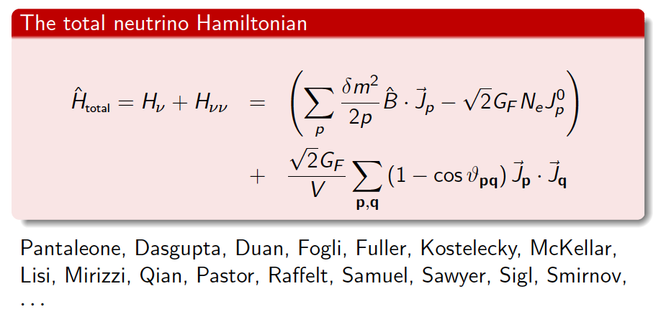


Slide 32
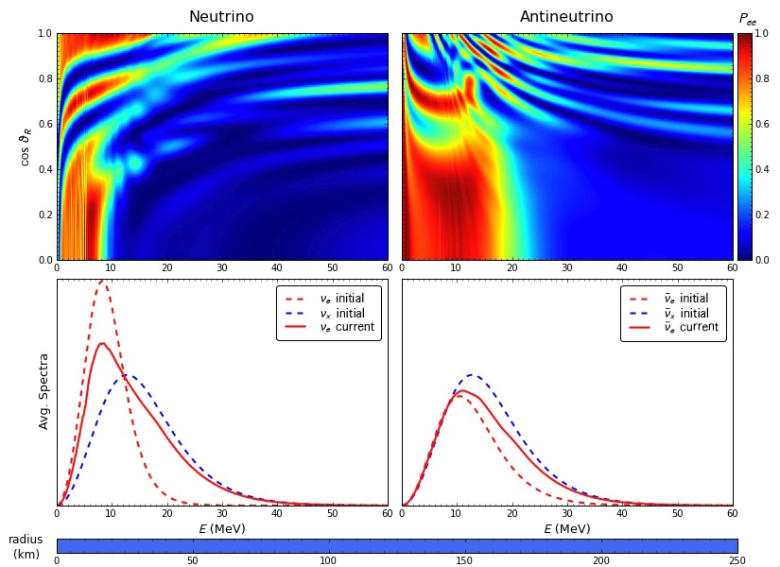
Fuller, Qian, Carlson, Duan

Slide 33
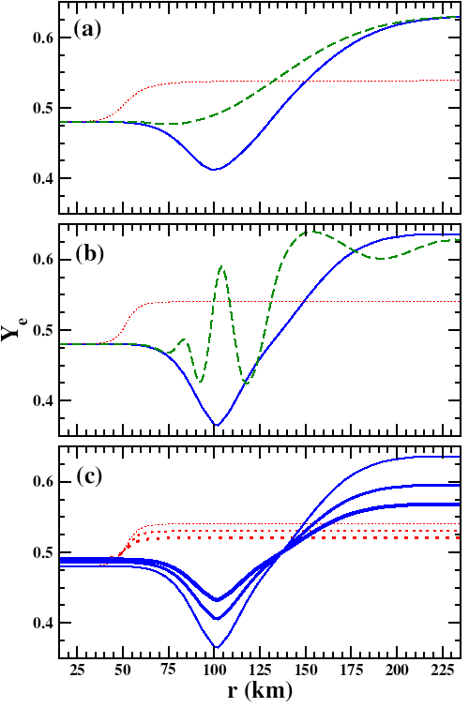
Equilibrium electron fraction with the inclusion of νν interactions
θ₁₃~π/10
L⁵¹ = 0.001, 0.1, 50
θ₁₃~π/20
Balantekin and Yuksel
θ₁₃~π/20 with α effect
X_{α}= 0, 0.3, 0.5 (thin, medium, thick lines)

Slide 34
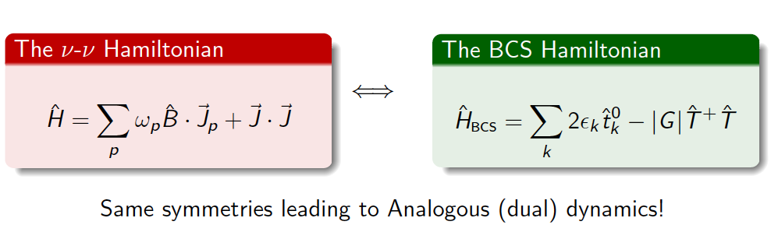
The duality between H_{νν} and BCS Hamiltonians

Slide 36
Pehlivan, Balantekin, Kajino and Yoshida, Phys. Rev. D84, 065008 (2011)

Slide 37
Spectral Splits

Slide 40
Dasgupta et al., 2009

Slide 41
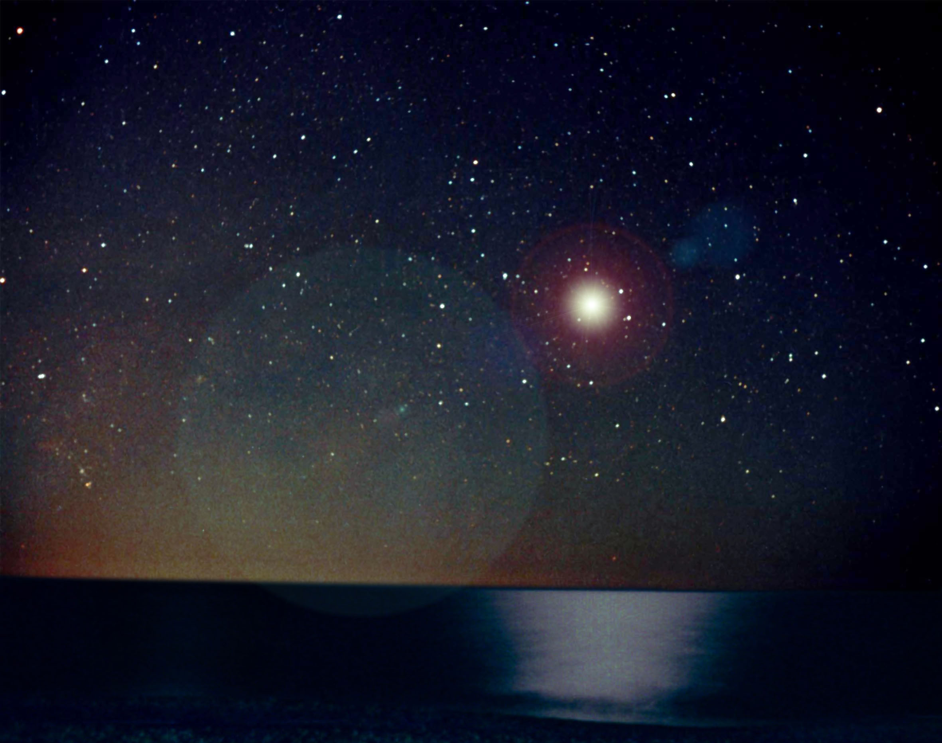
どうもありがとうございますた

