Slide 1
原始惑星系円盤から 周惑星円盤への固体の供給 - 衛星系形成モデルの構築に向けて -
谷川 享行
北大低温研
町田正博、丸田有希人 （九州大学）

Slide 2
Formation of Giant Planets
Giant planet formation
Solid planets (~10 Earth masses)
Instability of the atmosphere
Onset of gas accretion
Gap formation
Dissipation of the disk
Satellites are thought to be formed at very end stage of the giant planet formation.

Slide 3
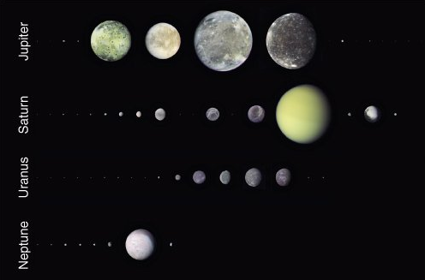
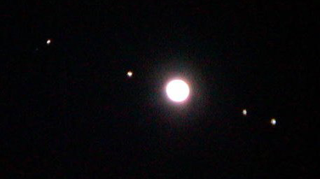
What is Satellite System?
Systems that consist of multiple objects rotating around planets
Generally exist around gas giant planets
Regular satellites and irregular satellites
Regular satellites:
Nearly circular orbits, orbital plane ~= equatorial plane
Occupy most of the total mass of satellites
→ Formed from circum-planetary disks?
Satellites of outer planets
Jupiter and Galilean satellites

Slide 4
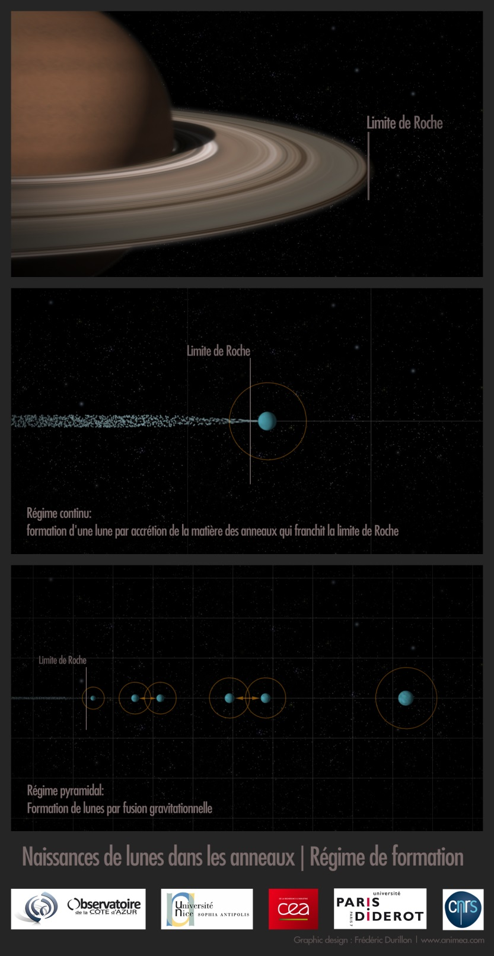
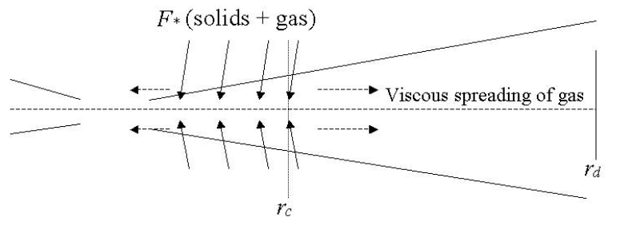
Three models
Courtesy of A. Crida
Minimum mass subnebula model
Massive disk at one time
Too high temperature for ice
Too fast Type I migration
Calisto’s partial differentiation
Gas-starved disk model
Canup and Ward 2002, 2006
Spreading tidal-disk model
Crida and Charnoz 2012
Canup and Ward 2002

Slide 5
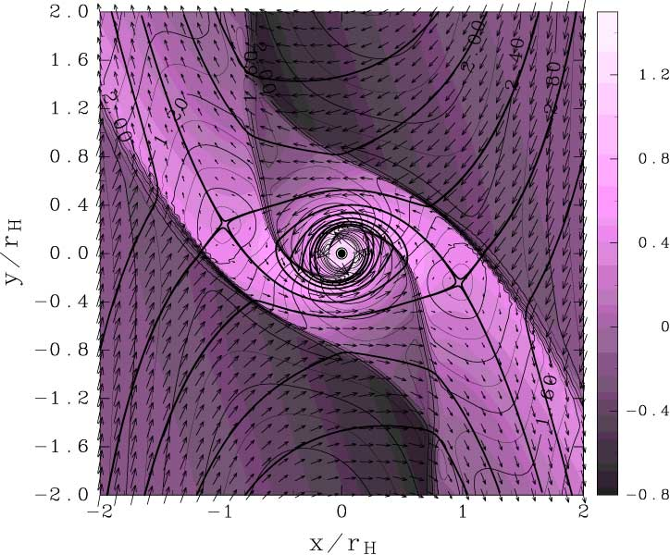
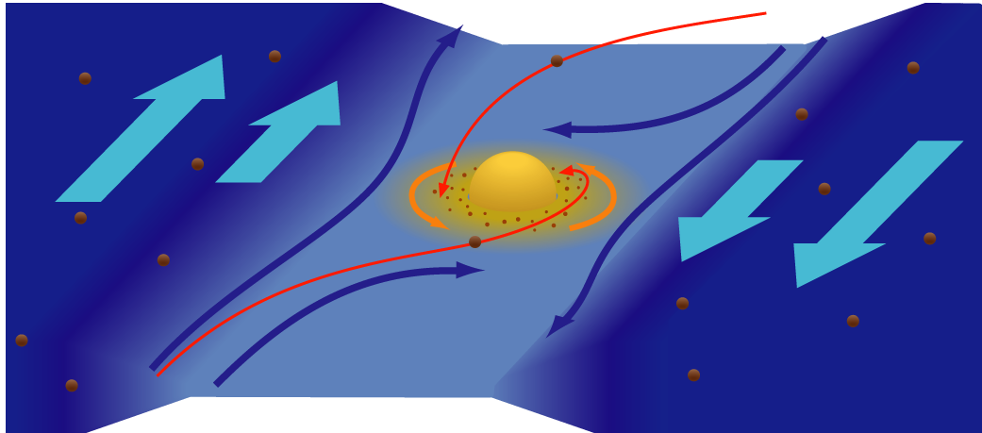
Structure of circum-planetary disk
Hydrodynamic simulation for growing gas giant planets
(e.g., Miki 1982, Lubow et al. 1999; Tanigawa, Ohtsuki, and Machida 2012)
Formation of circum-planetary gas disks
Tanigawa and Watanabe 2002
Sun
Proto-planetary disk
Tanigawa, Ohtsuki, and Machida 2012
How about solid materials?
Visualization by T. Takeda (CfCA, NAOJ)

Slide 6
Purpose of this study
We examine processes of supplying solid material to circum-planetary disks in order to address the formation of satellite systems.

Slide 7
Methods
Background gas flow
Tanigawa, Machida, and Ohtsuki 2012
Particle orbits are calculated on the Hill coordinate (restricted three-body problem) with gas drag.
Initial condition
e=i=0 at this stage.
Back ground gas velocity and density for gas drag are given by 3D hydrodynamic simulations (Tanigawa, Ohtsuki, and Machida 2012)
Visualization by T. Takeda (ヴェイサエンターテイメント)

Slide 8
Gas flow at the midplane
L=1
L=4
L=10
L=7

Slide 9
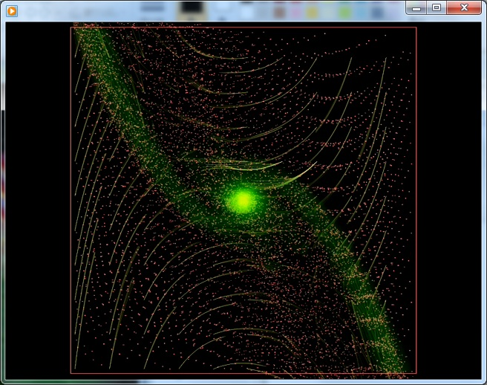
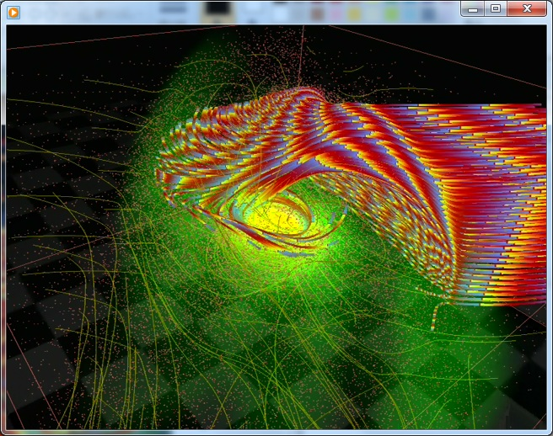
Visualization by T. Takeda
(ヴェイサエンターテイメント
← 4D2U project team, CfCA, NAOJ)
Shock surface
laminar flow
High altitude:
→ Fall and accretion
Shock surface
Circumplanetary disk
Midplane:
→ No accretion!

Slide 10
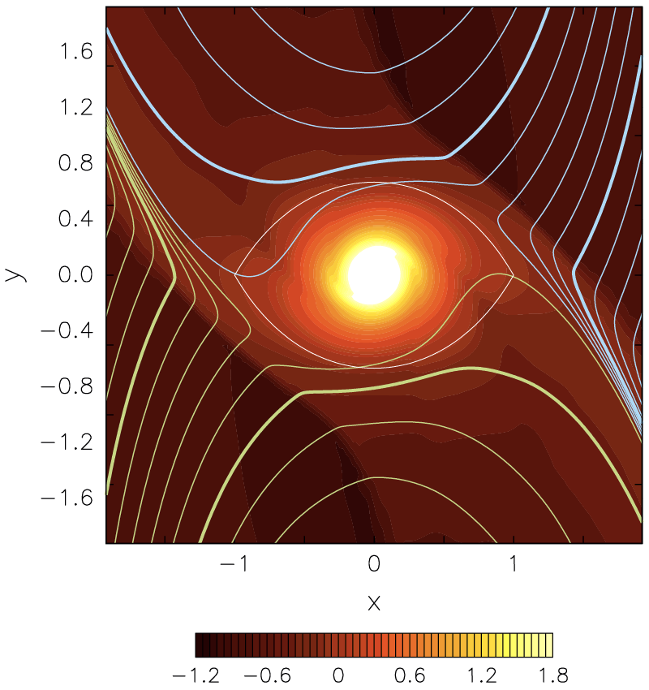
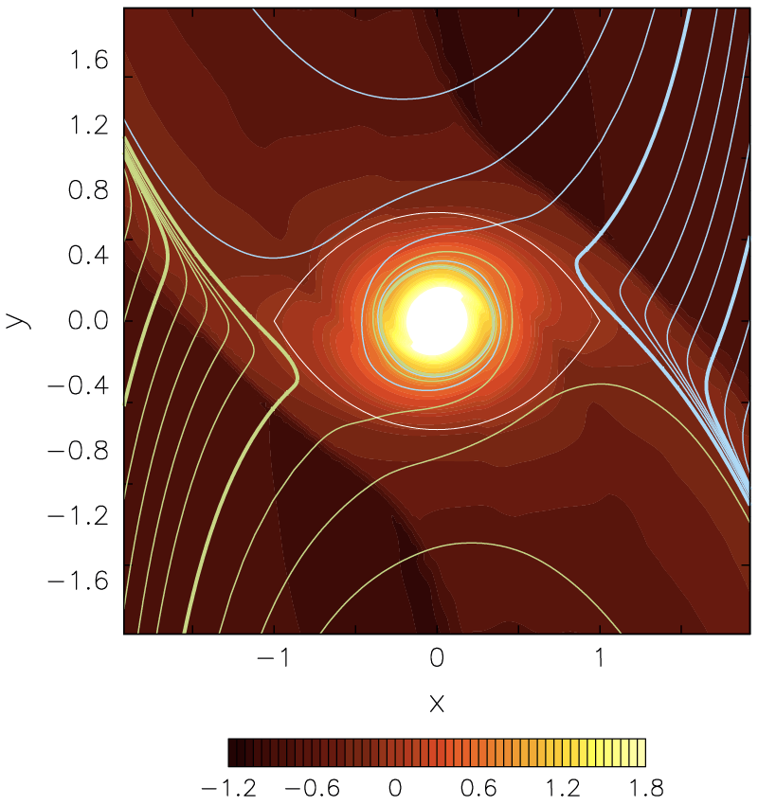
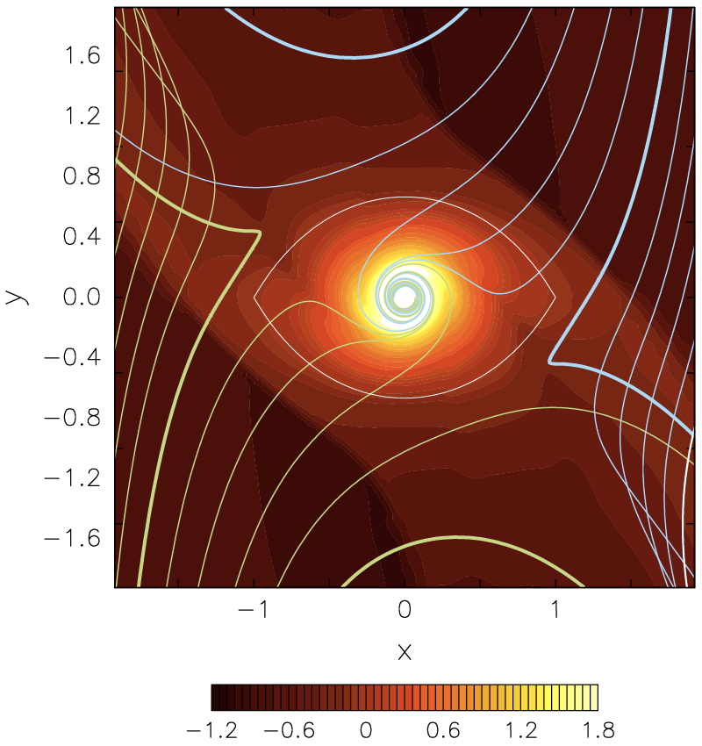
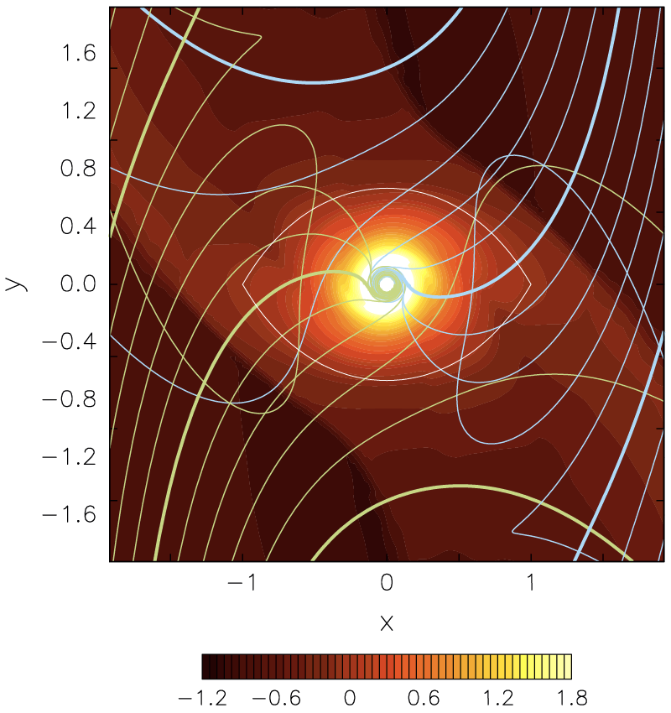
Strong gas-drag case
0.01m
0.1m
1m
10m
粒子サイズ小
カップリング強
カップリング弱
（ガス的運動）
（粒子的運動）
粒子サイズ大
降着位置：外側
降着位置：内側
降着幅：狭い
降着幅：広い

Slide 11
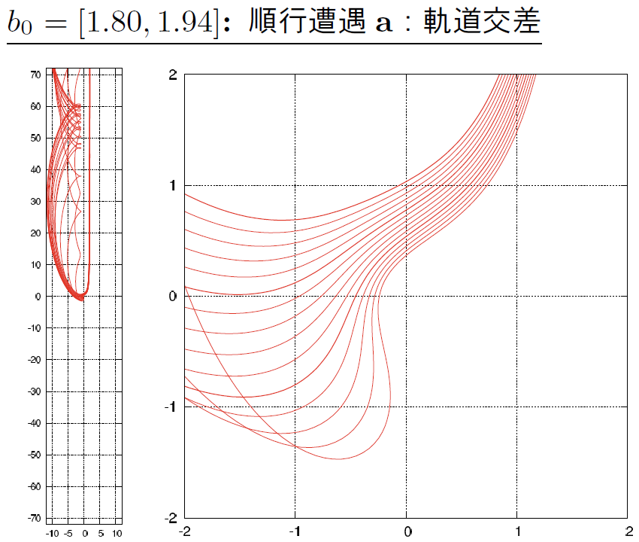
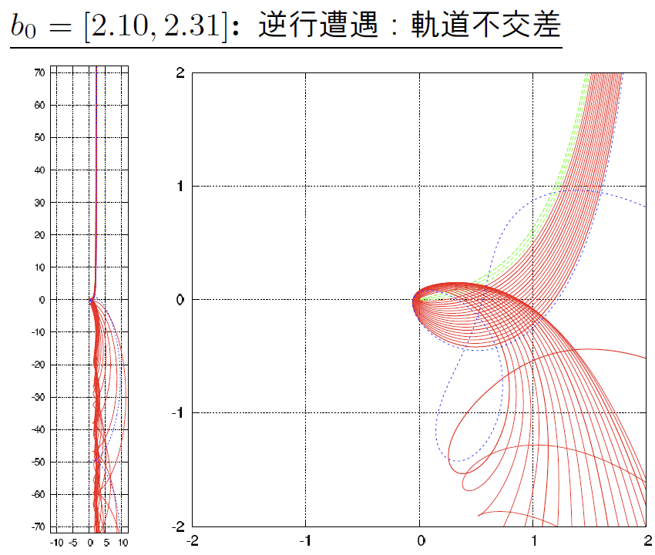
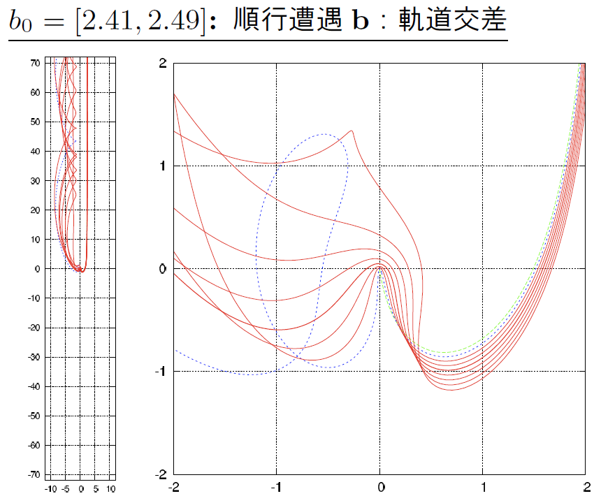
Gas-free case: Two encountering directions
See also Petit & Henon 1986, Ida & Nakazawa 1989
Prograde
Retrograde
Prograde
Minimum distance to the planet
Impact parameter b

Slide 12
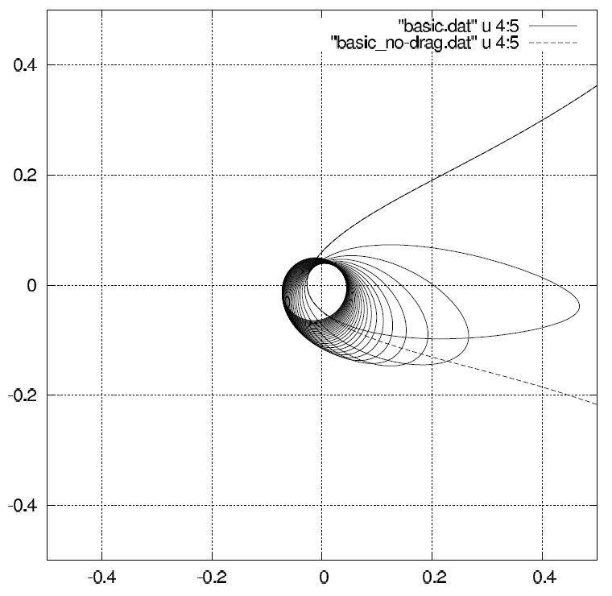
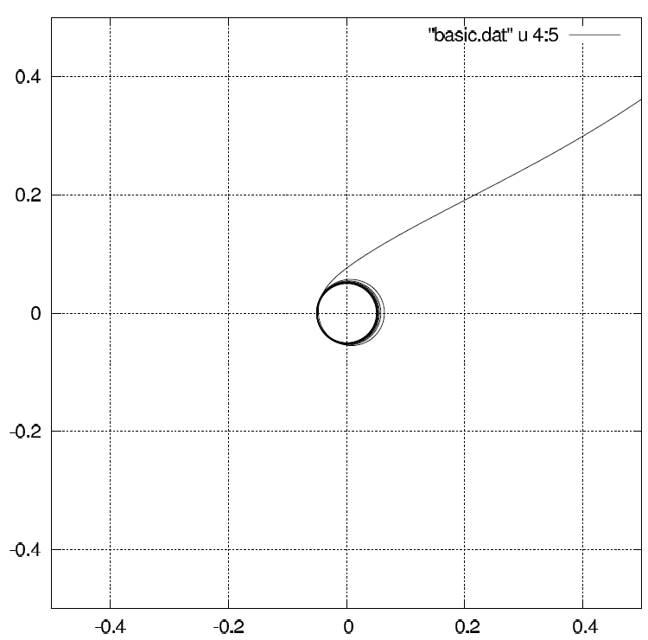
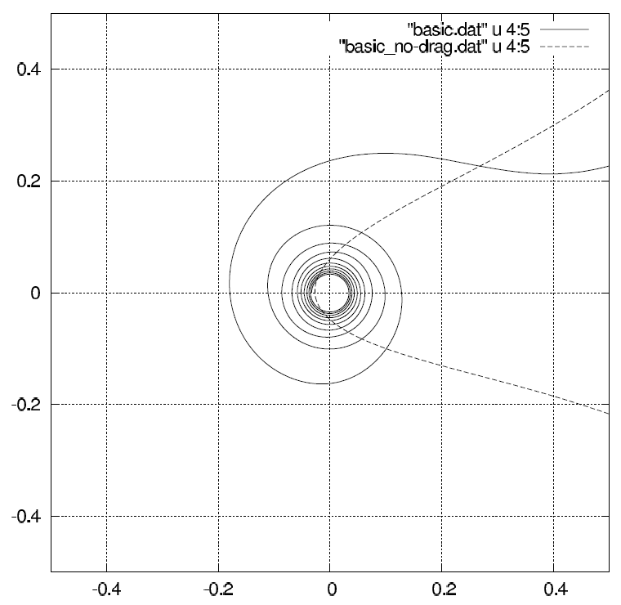
Weak gas-drag case: Typical orbits for prograde capture
r_{s} = 10⁴ m
r_{s} = 10² m
r_{s} = 10⁰ m
Captured for wide size range particles

Slide 13
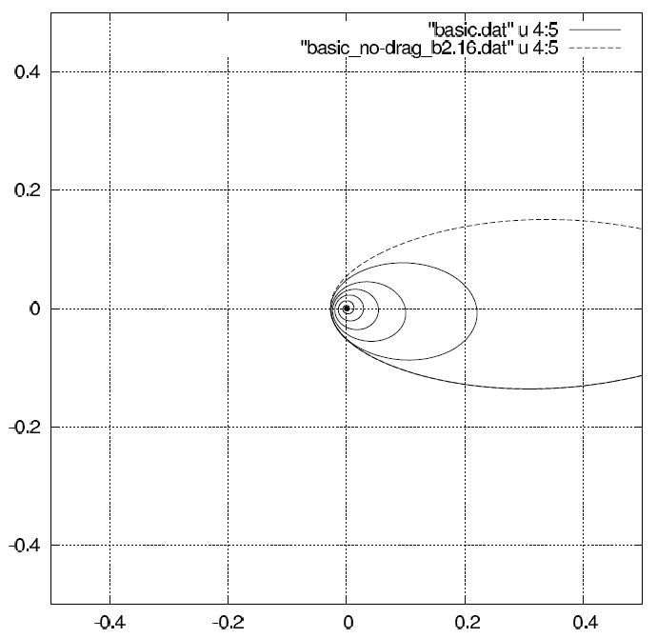
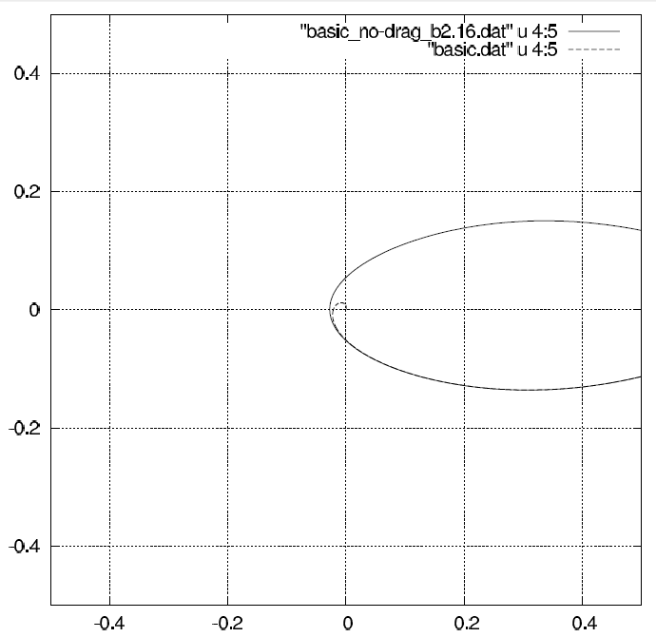
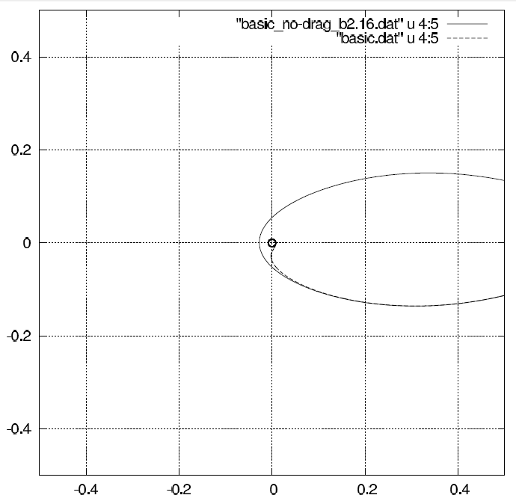
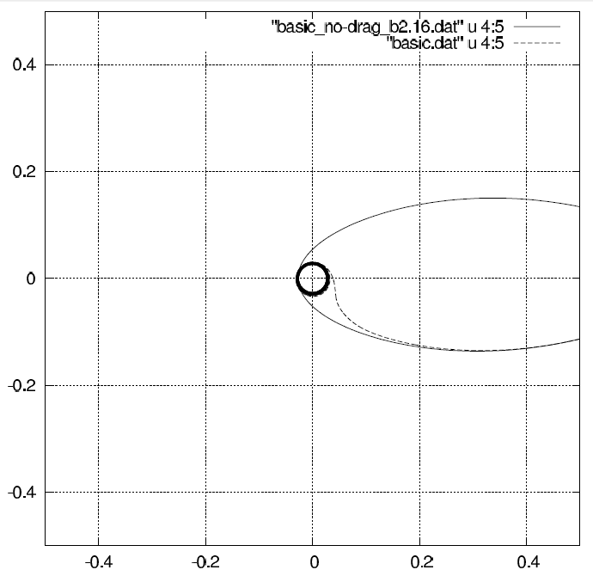
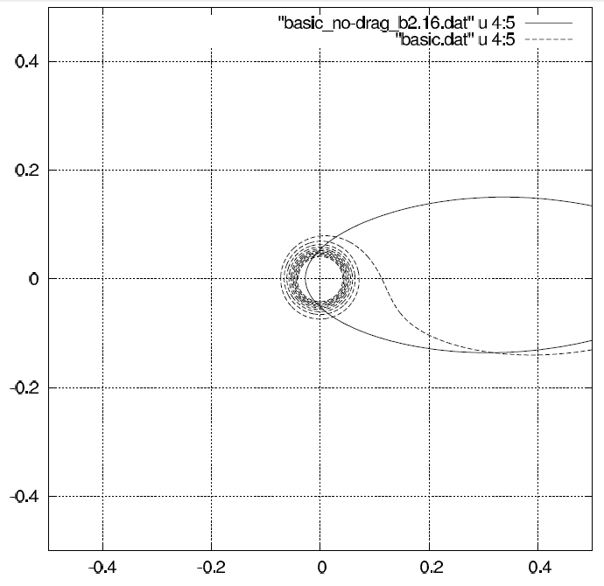
Weak gas-drag case: Typical orbits for retrograde capture
r_{s} = 10⁵ m
r_{s} = 10⁴ m
Fall to the planet
Change the rotating direction and then captured by the disk
r_{s} = 10³ m
r_{s} = 10² m
r_{s} = 10¹ m

Slide 14
Capture band and radius
10⁻¹m
10¹m
Distance from the planet
10³m
10⁵m
Impact parameter b

Slide 15
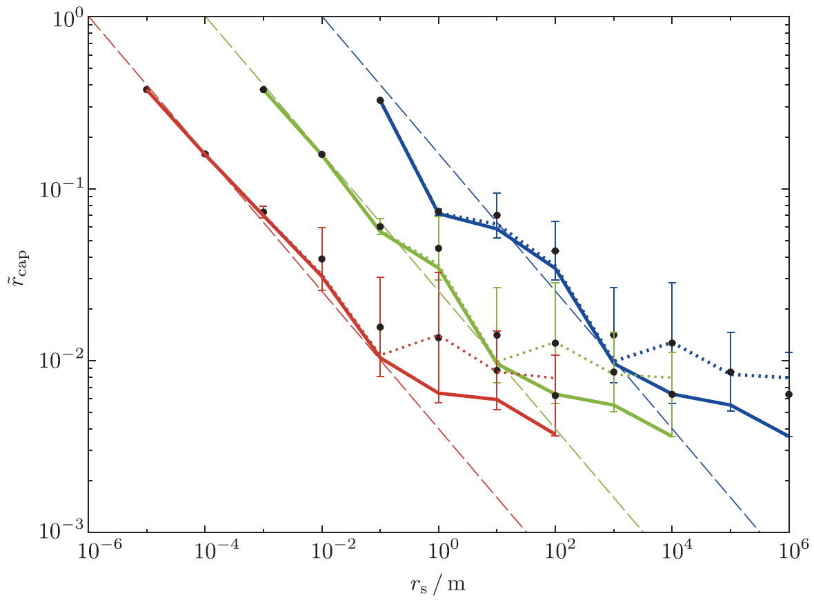
Capture rate and radius
Normalized capture rate
Captured radius
f_{dep} = 1
f_{dep} = 10⁻⁴
f_{dep} = 10⁻²
f_{dep} = 1
f_{dep} = 10⁻⁴
f_{dep} = 10⁻²
Size of incoming particle [m]
Size of incoming particle [m]
Fitting formula
where r_{s,peak} = 50 f_{dep,g} [m]

Slide 16
Surface density of solid particles in circumplanetary disks
Obtained fitting formulae
Normalized capture rate
Captured radius
Accretion rate of solid particles onto circumplanetary disks in real dimension
Dust drift velocity
Surface density of solid particles in circumplanetary disks

Slide 17
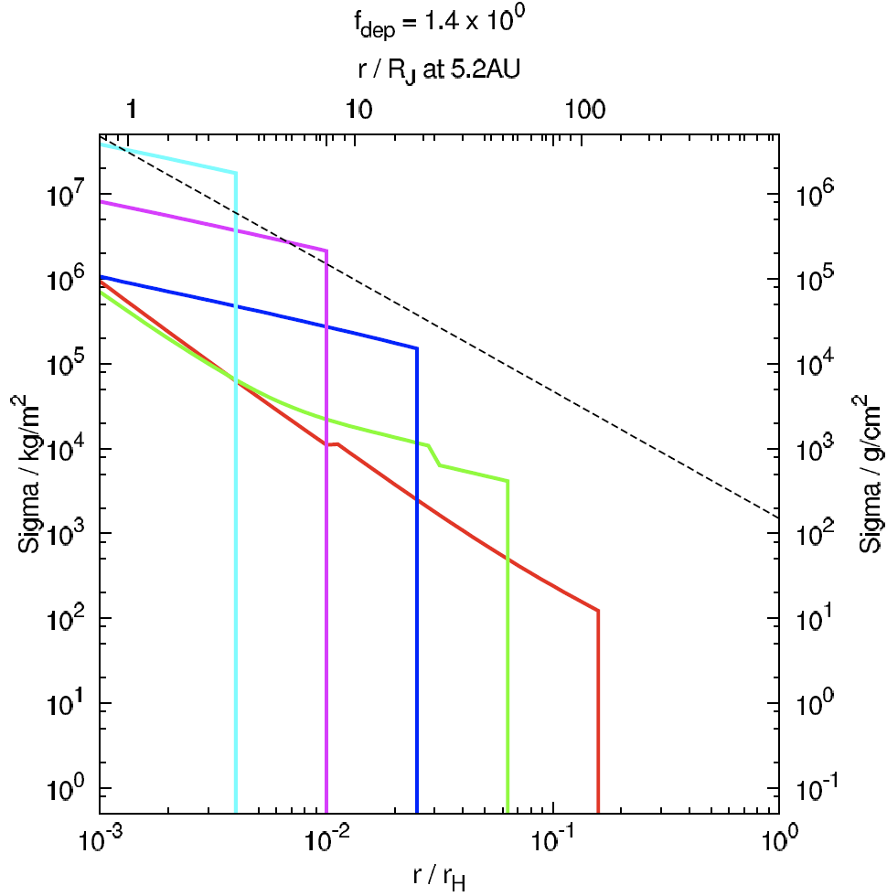
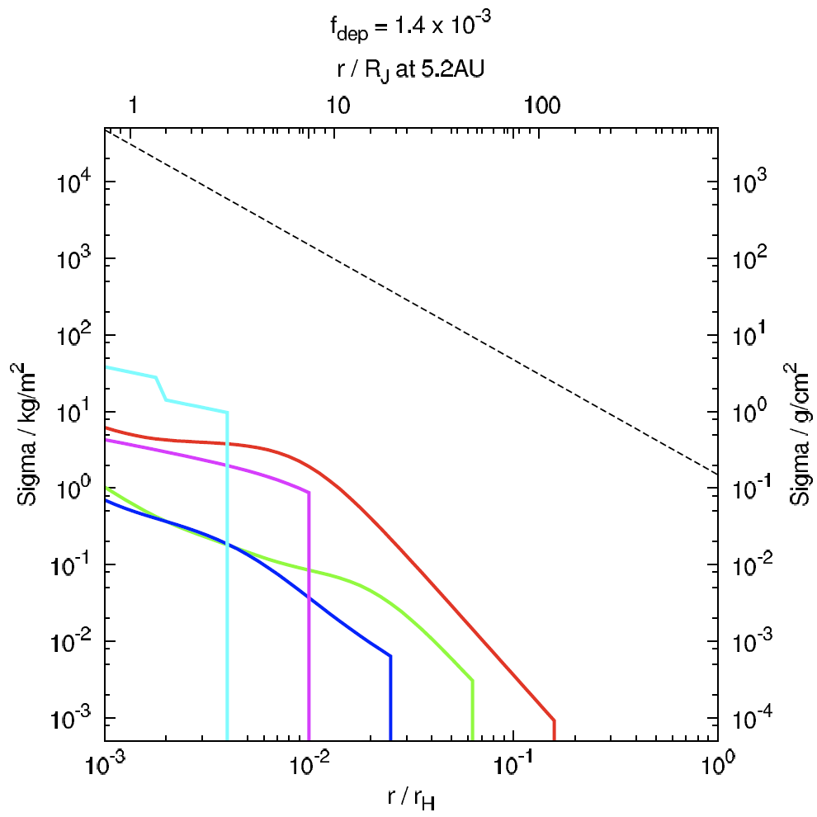
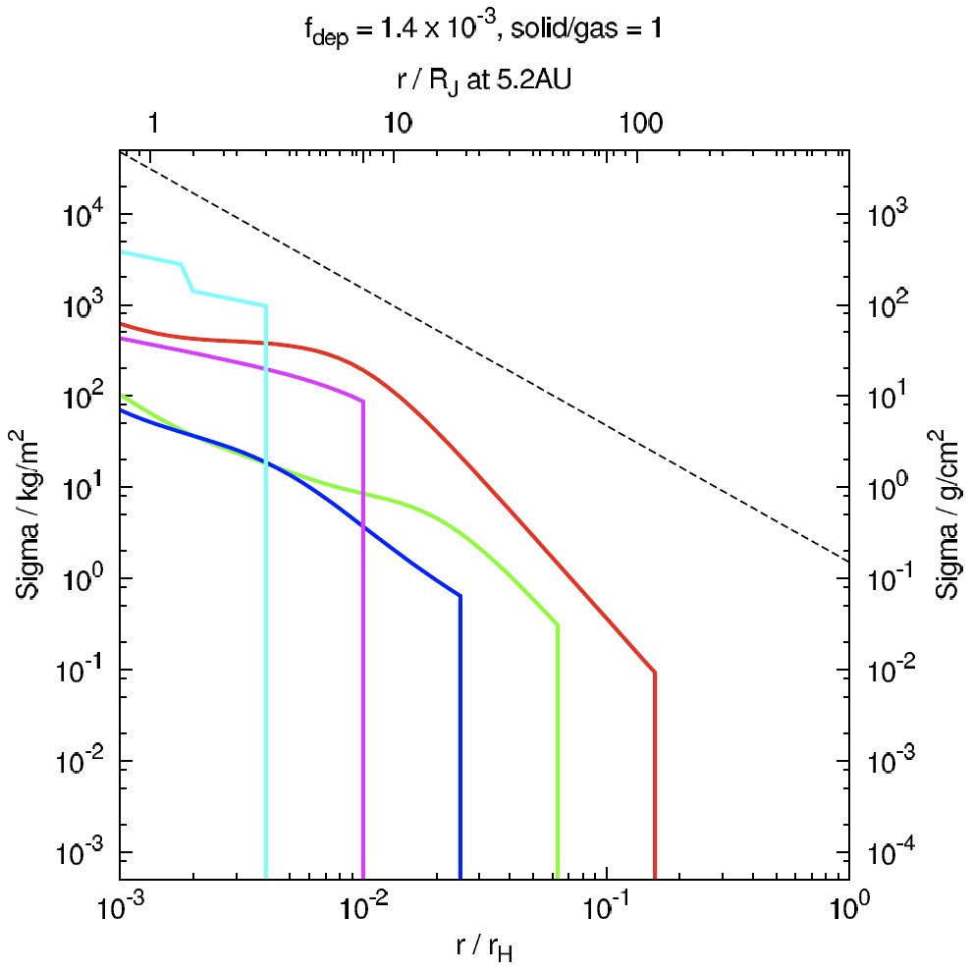
Surface density of solid particles
Standard disk
Depleted disk
Solid enriched disk
f_{dep} = 1.4x10⁰
f_{s/g} = 0.01
f_{dep} = 1.4x10⁻³
f_{s/g} = 0.01
f_{dep} = 1.4x10⁻³
f_{s/g} = 1
10⁷
10⁴
10⁴
gas
gas
gas
r_{s} = 10⁻³m
r_{s} = 10⁴m
r_{s} = 10⁰m
r_{s} = 10⁻³m
r_{s} = 10¹m
10⁰
10⁻³
r_{s} = 10¹m
10⁻³
ガス面密度高い
→ 高温 → 氷気化
ガス面密度 ＯＫ
固体面密度不足
ガス面密度 OK
固体面密度 OK
Solid to gas ratio of incoming flow bands should be much higher (~1) than that of solar composition (~0.01).
f_{dep} = gas depletion factor
f_{s/g} = solid to gas ratio

Slide 18
Future works to clarify satellite formation processes
this study
原始惑星系円盤
ガス惑星軌道近傍の固体のサイズ分布（小林＠名大）
原始惑星系円盤からの物質供給
pressure bump による固体供給の律速（瀧＠東工大）
ガス供給率：原始惑星系円盤中のギャップの深さ（金川＠北大）
固体供給率
固体の供給位置
周惑星円盤
ガスの面密度（藤井＠名大）
固体の面密度（成長を無視した場合）
固体の成長（合体成長方程式、N体計算）（奥住＠東工大、荻原＠名大）
available
on going?
Sun
Proto-planetary disk

Slide 19
Summary
We examined accretion of solid particles that is originally rotating in heliocentric orbit onto circumplanetary disks by orbital integration with gas drag.
We use the gas flow that was obtained by 3D high-resolution hydrodynamic simulations (Tanigawa et al. 2012).
No back reaction to the gas flow
Limited on the midplane (particle motions are 2D) for now.
Retrograde encounter region accounts for the accretion of solid particles onto the circumplanetary disk.
Accretion rates are enhanced for 10-1000m sized particles.
The size decreases with decreasing gas density.
The size would decreases with time.
Fitting formula of accretion rates as a function of particle size.
Position to be captured in the circumplanetary disks becomes closer to the planet with increasing particle size.
Solid to gas ratio of the accretion flow should be much higher than that of solar composition to form satellite systems.

